Slide 1
Supervisor Meeting
G3T3
Tan Zhi Hui
Jeremy Ong
Shu Wen
Nabilah
Darren Tay

Slide 2
Meeting Agenda
Progress
Goals for next iteration
Milestone
Problems
Respective roles & tasks
Metrics

Slide 3
CYAN
Required Functionalities:
Login
Bootstrap
Basic App Usage Report
Top-k App Usage Report
Smartphone Overuse Report
Dual interfaces
Loading location data
Deletion of data
Smartphone Usage Heatmap
Social Activeness Report

Slide 4
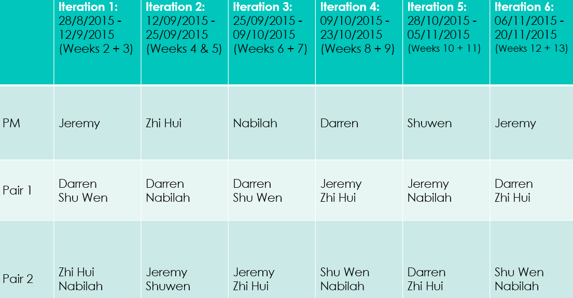

Slide 5
Progress
Iteration 1 – Planning & Design
Current Iteration
Planning – setting of foundation
Use Case Diagram
ERD model
Domain Diagram
Bootstrap Sequence Diagram
Revise of existing diagram
Set up Task Metric & PPlogs
Design remaining diagram
Class Diagram
Coding for bootstrap
Develop test cases and test file for bootstrap
Deploy and Test bootstrap functions

Slide 6
Time Boxing
Project can be completed within the time
Keep to schedule
Sufficient buffer time
Notes:
Do not want spill over to affect other functionalities

Slide 7
Goals for next two weeks
Complete implementation of basic functionalities
Bootstrap
Login / logout
CRUD
Standardise UI for admin and user platform

Slide 8
Milestone
Finish the diagrams
Load function (Bootstrap) successful implemented
Functional for admin to upload
Notes:
Finished preparation to delve into it

Slide 9
Problems
Exiting
Potential
Not detailed enough for the diagram, coder might not be able to code [RESOLVED]
Team might be unfamiliar (JSON)
Wrong Estimation of time needed for Bootstrap functionality

Slide 10
Risk Assessment
S/N | Risk Statement | Consequence | Likelihood | Impact | Level | Mitigation Strategy
1 | Team might be unfamiliar in coding in NetBeans and new language JSON | Delays in bootstrap function due to incorrect time estimates | High | High | A | Team to research and understand JSON Bootstrap Function will be given 1 and half iteration

Slide 11
Roles and Tasks
Member(Role) | Iteration | Tasks
Jeremy Ong (PM) | 1 | Project schedule Use-Case diagram Domain Diagram Update next Iteration schedule PM handover
Jeremy Ong (Pair 2) | 2 | Sequence Diagram for Basic App Usage Report Sequence Diagram for Top-k app Usage Report Sequence Diagram for Smartphone overuse report Sequence diagram for deleting location data Prepare test case and test files for testing Class Diagram

Slide 12
Roles and Tasks
Member(Role) | Iteration | Tasks
Tan Zhi Hui (Pair 2) | 1 | Bootstrap Sequence Diagram
Tan Zhi Hui (PM) | 2 | Preparation slides for supervisor meeting Task Metric Test Plan Update of Sequence diagram for bootstrap Update next Iteration schedule PM handover Testing of bootstrap

Slide 13
Roles and Tasks
Member(Role) | Iteration | Tasks
Darren Tay (Pair 1) | 1 | ERD model
Darren Tay (Pair 1) | 2 | Sequence Diagram for Bootstrap Location Data Code Bootstrap UI, Logic and JSON Deploy to openShift Debugging (if any)

Slide 14
Roles and Tasks
Member(Role) | Iteration | Tasks
Nabilah (Pair 2) | 1 | Bootstrap Sequence Diagram
Nabilah (Pair 1) | 2 | Sequence Diagram for Bootstrap Location Data Code Bootstrap UI, Logic and JSON Deploy to openshift Debugging (if any) Update Sequence Diagram for bootstrap

Slide 15
Roles and Tasks
Member(Role) | Iteration | Tasks
Yee Shu Wen (Pair 1) | 1 | ERD model
Yee Shu Wen (Pair 2) | 2 | Sequence Diagram for Basic App Usage Report Sequence Diagram for Top-k app Usage Report Sequence Diagram for Smartphone overuse report Sequence diagram for deleting location data Prepare test case and test files for testing Class Diagram

Slide 16
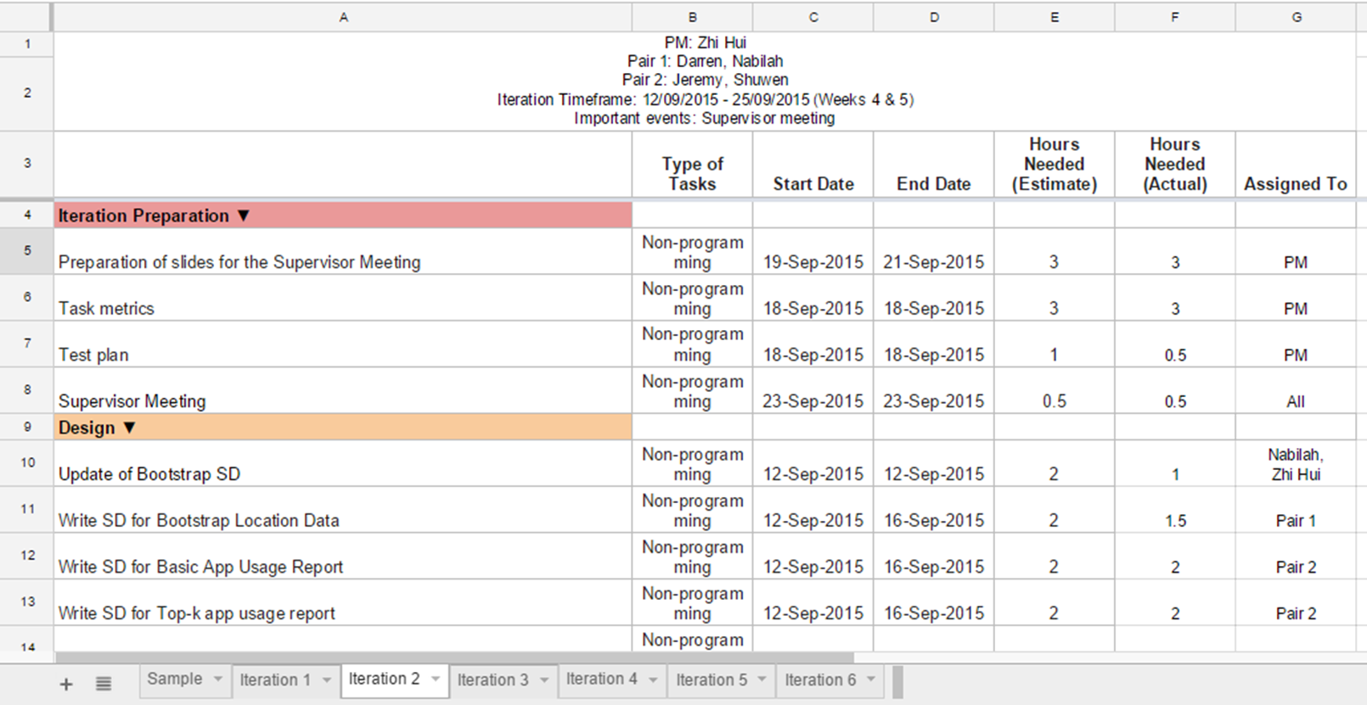
Task Metrics
Notes:
https://docs.google.com/spreadsheets/d/1U8LG0BXlGYPczp9xnIFViaP86-Oerd2kIQKZnwwWPG4/edit#gid=544402806

Slide 17
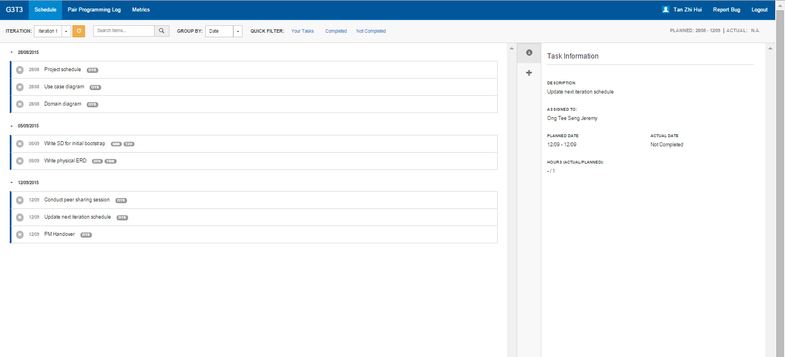
PPLogs
Notes:
http://green.smu.edu.sg/pplog/

Slide 18
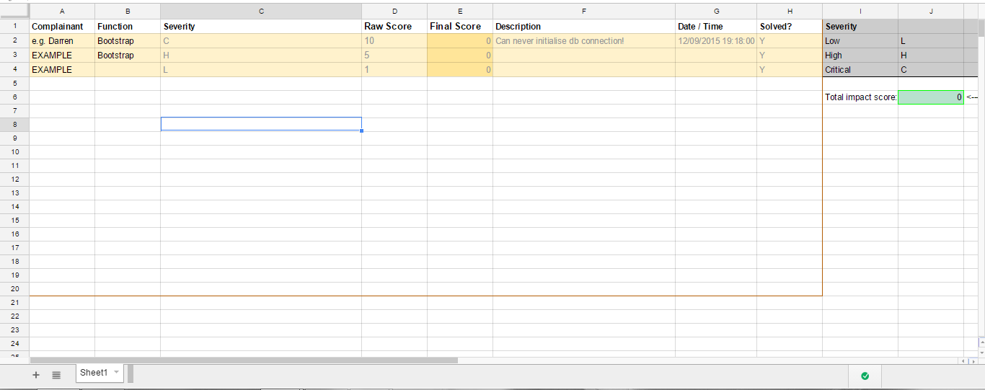
Bug Metric
Notes:
https://docs.google.com/spreadsheets/d/1Sp80UyYZO_gT89sFfwVYJIofxsbHAiiVybEl8Qu1xrA/edit#gid=0
Score should not be >= 10

Slide 19
Critical Path
Implement Bootstrap
(4 days)
Implement CRUD Location
Data
(3 day)
Design Bootstrap diagram
(2 days)
Integrate functionalities
(2 days)
Design other Diagrams (5 days)
Implement
Login / Logout
(2 day)
Buffer
(1 day)
Notes:
Critical path -
Time boxing, task based
If the task is brought to the next iteration, can the same pair finish coding for the function
If a task is brought to the next iteration, does it means that the rest might need to be adjusted

